Slide 1


FILE ORGANIZER
PROJECT

Slide 2
Name: Mohsin Zeb
Intern ID: TN/IN02/PY/019
Email ID : mohsinzebsm@gmail.com
Domain: Python Development

Slide 3
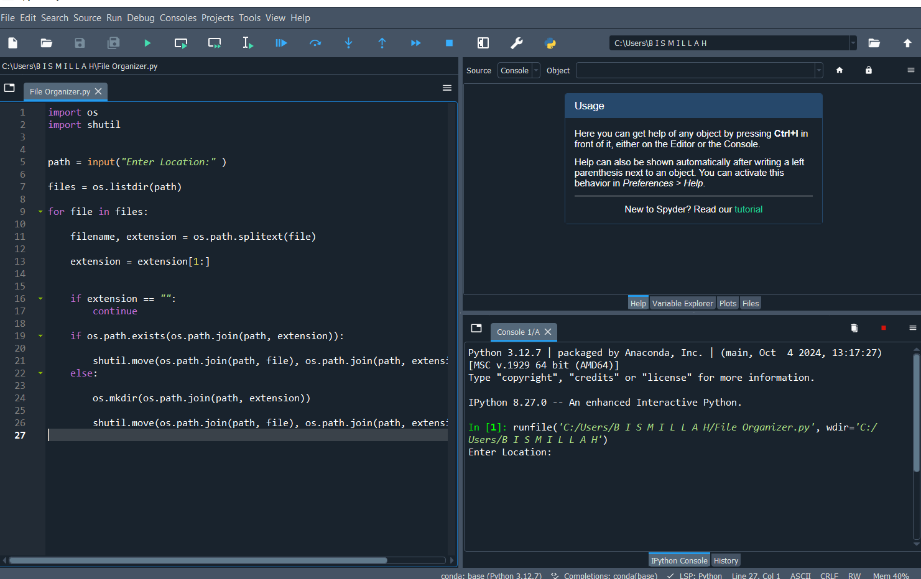
What is the File Organizer?
A Python program to organize files in directories automatically.
It organize files according to their Extension
Reduces clutter by sorting files based on type, date, or user-defined categories.
Saves time and improves productivity.

Slide 4
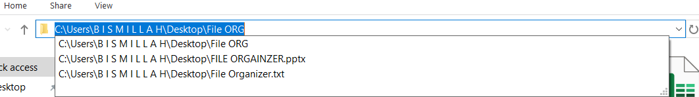
PATH LOCATION
Features
FILE MANAGING
Easy Configuration
Categorizes files by type (e.g., documents, images, videos).
Sorts by creation and extension data.
Simply put Path of directory and it will organize files
Handles custom folder structures.
Supports bulk processing.
Easy to configure and use

Slide 5
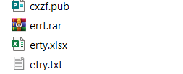
FILE NAME
How It Works
Specify the directory path to organize.
Program scans path and files and identifies their types through their extension by listing them first.
It will create the Folders for those files
Moves files to appropriate folders based on predefined rules and extension.
EXTENSION

Slide 6

Code Snippet
import os
import shutil
path = input("Enter Location:" )
files = os.listdir(path)
for file in files:
filename, extension = os.path.splitext(file)
extension = extension[1:]
if extension == "":
continue
if os.path.exists(os.path.join(path, extension)):
shutil.move(os.path.join(path, file), os.path.join(path, extension, file))
else:
os.mkdir(os.path.join(path, extension))
shutil.move(os.path.join(path, file), os.path.join(path, extension, file))
HELPS IN MODIFING THE DIRECTORIES
ASK For location
Store list of files in FILES variable
Split the files into name and extension and assigning them to variables respectively
Accessing Extension by using index
If no extension then continue
Checks if a folder by that extension name already exists
Simply move files to existing folder
If no folder exist, then it will creare the folder for each extension
Move the files to newly created folders

Slide 7
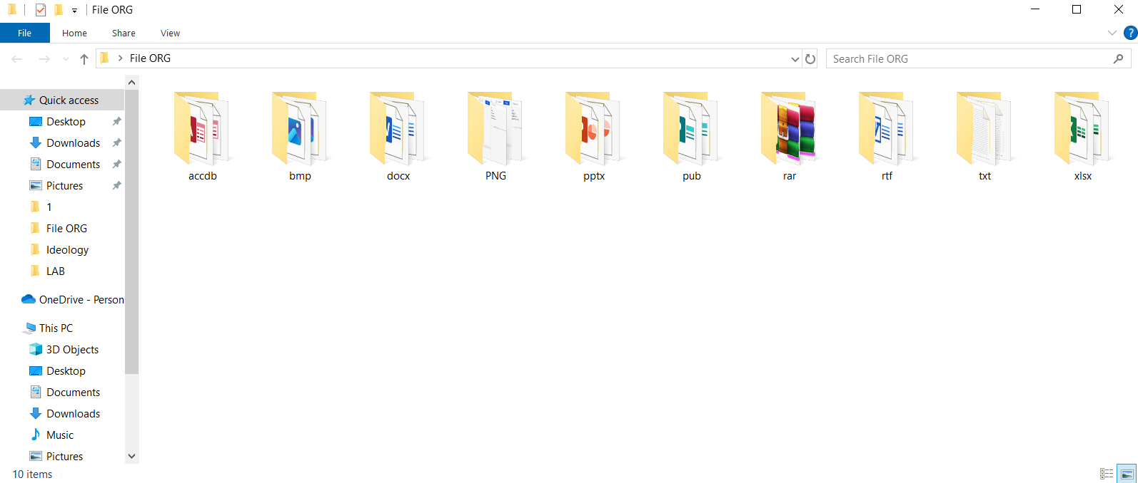
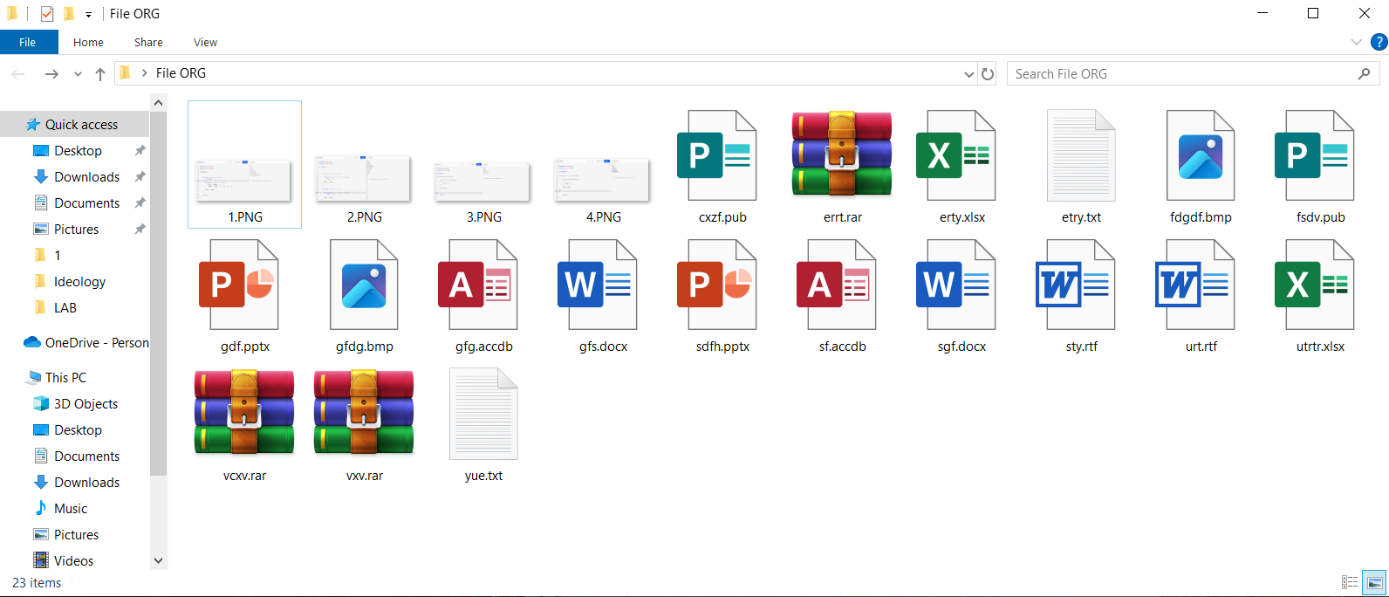
Benefits
Saves hours of manual file sorting.
Keeps directories neat and accessible.
Reduces errors in file management.
Highly customizable for various needs.

